Slide 1
BASIC OPERATIONS ON Pointers AND POINTERS TO ARRAYS

Slide 2
Pointers and arrays
When an array is declared, the compiler allocates a base address and sufficient amount of storage to contain all the elements of the array in contiguous memory locations.
The base address is the location of the first element (index 0) of the array.
The compiler also defines the array name as a constant pointer to the first element.

Slide 3
Pointers and arrays
An array x is declared as follows and assume the base address of x is 1000.
int x[5] ={ 1,2,3,4,5};
Array name x, is a constant pointer, pointing to the first element x[0] .
Value of x is 1000 (Base Address), the location of x[0]. i.e. x = &x[0] = 1000 (in the example below)
Notes:
Consider the following:
int my_array[] = {1,23,17,4,-5,100};
Here we have an array containing 6 integers. We refer to each of these integers by means of a subscript to my_array, i.e. using my_array[0] through my_array[5]. But, we could alternatively access them via a pointer as follows:
int *ptr; ptr = &my_array[0]; /* point our pointer at the first integer in our array */

Slide 4
Array accessing using Pointers
An integer pointer variable p, can be made to point to an array as follows:
int x[5] ={ 1,2,3,4,5};
int *p;
p = x; OR p = &x[0];
Following statement is Invalid:
p = &x ; //Invalid
Successive array elements can be accessed by writing:
printf(“%d”, *p); p++;
or
printf(“%d”, *(p+i)); i++;
Notes:
The name x is defined as a constant pointer pointing to the first element, x[0] and therefore the value of x is 1000, the location where x[0] is stored.
i.e. is x =&x[0] →1000;
If we declare p as an integer pointer, then we can make the pointer p point to the array x by the following statement:
p=x; OR p=&x[0];
The following statement is invalid as value of x is 1000 (base address) and then we are applying address of operator on a constant:
p=&x;

Slide 5
Pointers and arrays
The relationship between p and x is shown below:
p= &x[0]; (=1000) BASE ADDRESS
p+1=>&x[1] (=1004)
p+2=>&x[2] (=1008)
p+3=>&x[3] (=1012)
p+4=>&x[4] (=1016)
Address of an element of x is given by:
Address of x[i] = base address + i * scale factor of (int)
Address of x[3]= 1000 +(3*4) = 1012

Slide 6
Array accessing using array name as pointer - Example
#include <stdio.h>
int main()
{
int arr[5] = { 31, 54, 77, 52, 93 };
Int j;
for( j=0; j<5; j++) //for each element,
printf(“%d ”, *(arr+j)); //print value
return 0;
}
Notes:
Array name is a constant pointer. We can access the array elements by adding the index value to array name. Since array name is constant pointer, we cannot apply increment/decrement operator on it.(arr++).

Slide 7
Array accessing using Pointers - Example
// array accessed with pointer
#include <stdio.h>
int main()
{
int arr[5] = { 31, 54, 77, 52, 93 };
int* ptr; //pointer to arr
ptr = arr; //points to arr
for(int j=0; j<5; j++) //for each element,
printf("%d ", *ptr++);
return 0;
}
“ptr” is a pointer which can be used to access the elements.

Slide 8
Sum of all elements stored in an array
#include <stdio.h>
int main()
{
int *p, sum=0, i=0;
int x[5] ={5, 9, 6,3,7};
p=x;
while(i<5)
{
sum+=*p;
i++;
p++;
}
printf("sum of elements = %d“, sum);
return 0;
}

Slide 9
Pointers & Character strings
//length of the string
#include <stdio.h>
int main()
{
char name[15];
char *cptr=name;
printf("Enter some word to find its length: \n“);
scanf(“%s”, name);
while(*cptr!= '\0')
cptr++;
printf("length= %d"cptr-name);
return 0;
}

Slide 10
Pointers & Character strings
The statements
char name[10];
char *cptr =name;
declares cptr as a pointer to a character array and
assigns address of the first character of name as the
initial value.
The statement while(*cptr!=‘\0’)
is true until the end of the string is reached.
When the while loop is terminated, the pointer cptr holds the address of the null character [‘\0’].
The statement length = cptr – name; gives the length of the string name.

Slide 11
Pointers & Character strings
A constant character string always represents a pointer to that string.
The following statements are valid.
char *name;
name =“Delhi”;
These statements will declare name as a pointer to character array and assign to name the constant character string “Delhi”.

Slide 12
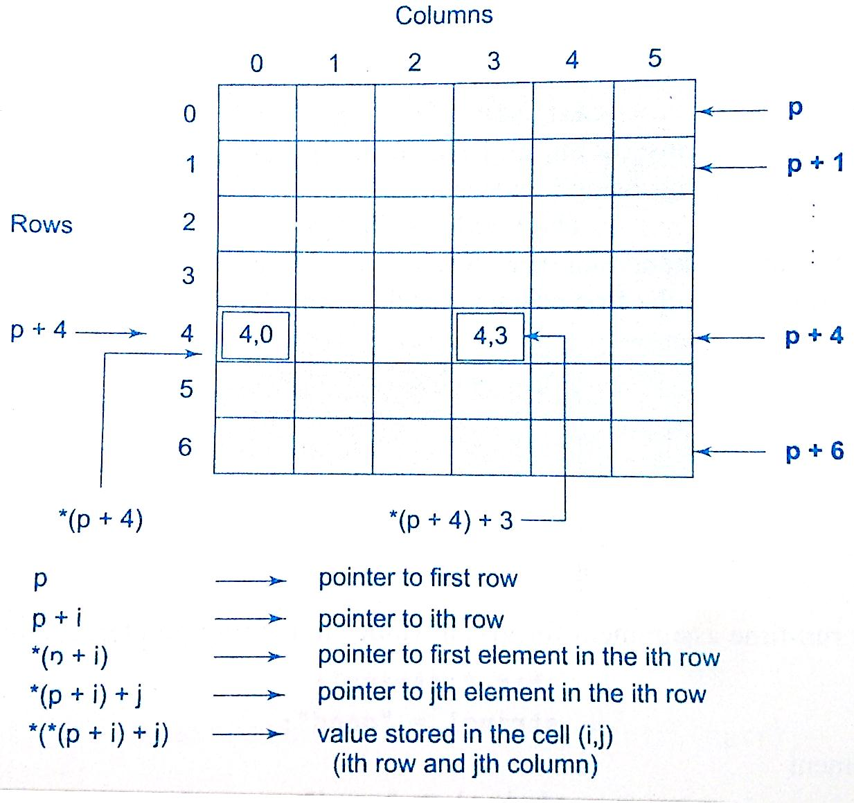
Pointers and 2D arrays
int a[][2]={ {12, 22},
{33, 44} };
int (*p)[2];
p=a; // initialization
Element in 2d represented as
*(*(a+i)+j)
or
*(*(p+i)+j)

Slide 13
Pointers and 2D arrays
// 2D array accessed with pointer
#include <stdio.h>
int main()
{
int i, j, (*p)[2], a[][2] = {{12, 22}, {33, 44} };
p=a;
for(i=0;i<2;i++)
{
for(j=0;j<2;j++)
printf(“%d \t“, *(*(p+i)+j));
printf("\n“);
}
return 0;
}

Slide 14
Array of pointers
We can use pointers to handle a table of strings.
char name[3][25];
name is a table containing 3 names, each with a maximum length of 25 characters (including ‘\0’)
Total storage requirement for name is 75 bytes.
But rarely all the individual strings will be equal in lengths.
We can use a pointer to a string of varying length as
char *name[3] = { “New Zealand”, “Austrailia”, “India” };

Slide 15
Array of pointers
So, char *name[3] = { “New Zealand “,
“Australia”,
“India”};
Declares name to be an array of 3 pointers to characters, each pointer pointing to a particular name.
name[0] → New Zealand
name[1]→ Australia
name[2]→ India
This declaration allocates 28 bytes.

Slide 16
Array of pointers
The following statement would print out all the 3 names.
for(i=0; i<=2;i++)
printf(“%s”,name[i]);
or printf(“%s”, *(name + i));
To access the j^{th} character in the i^{th} name, we
may write as
*(name[i] +j)
The character array with rows of varying lengths are called ragged arrays and are better handled by pointers.

Slide 17
Pointer to Void Type
The void pointer in C is a pointer which is not associated with any data types.
It points to some data location in the storage means points to the address of variables. It is also called general purpose pointer.
#include<stdlib.h>
int main() {
int a = 7;
float b = 7.6;
void *p;
p = &a;
printf("Integer variable is = %d", *( (int*) p) );
p = &b;
printf("\nFloat variable is = %f", *( (float*) p) );
return 0;
}

Slide 18
Pointer to Void Type
#include<stdlib.h>
int main() {
int a = 7;
float b = 7.6;
void *p;
p = &a;
printf("Integer variable is = %d", *( (int*) p) );
p = &b;
printf("\nFloat variable is = %f", *( (float*) p) );
return 0;
}
OUTPUT:
Integer variable is = 7
Float variable is = 7.600000

